Slide 1
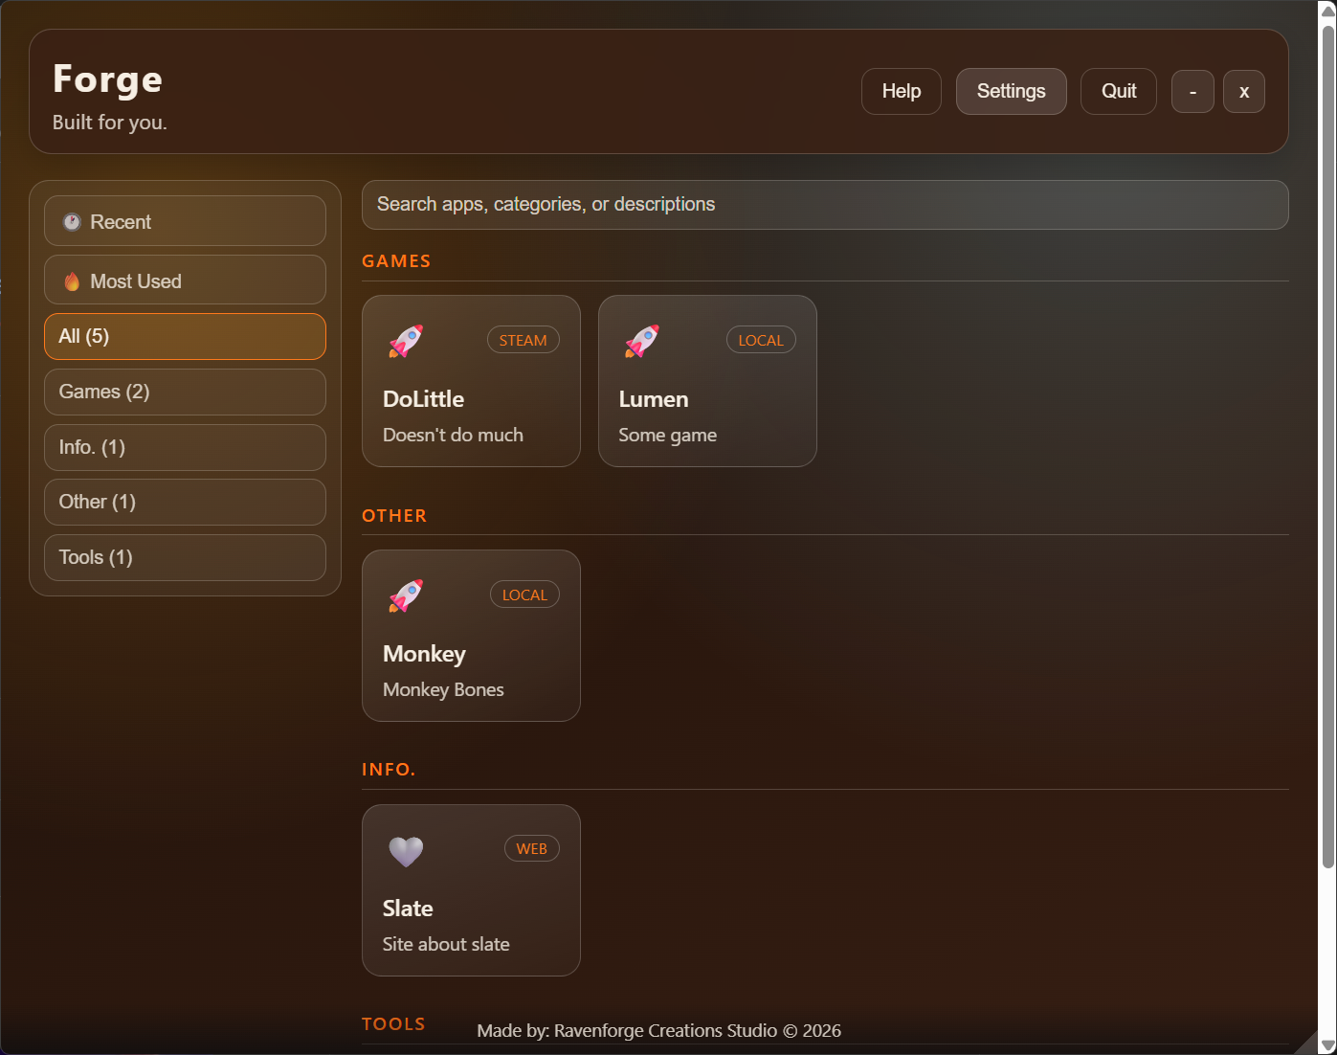
Forge: Multipurpose Launcher A customizable desktop command center for faster daily workflows
Launch faster. Organize smarter. Recover safely.

Slide 2
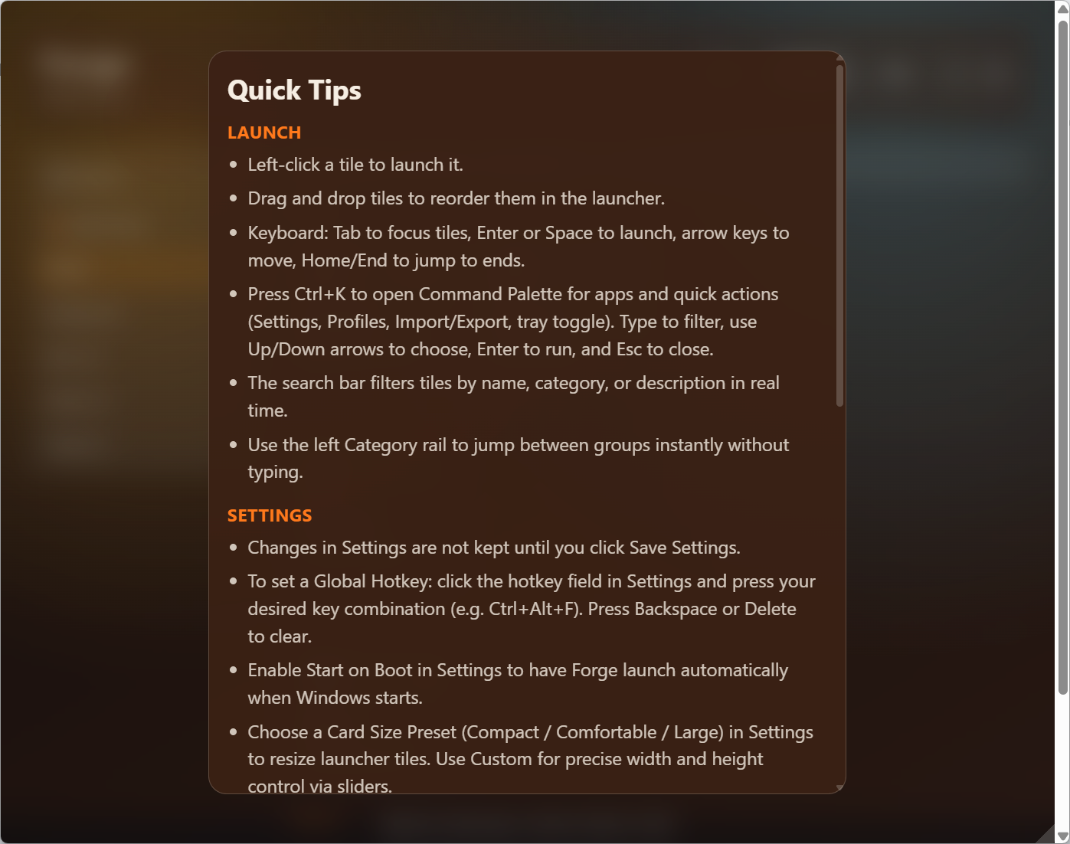
Problem and Opportunity
Daily context switching wastes time and focus
Existing launchers are often rigid or shallow
Users need one place for apps, links, and routine actions
Opportunity: combine speed, customization, and resilience in one desktop tool

Slide 3
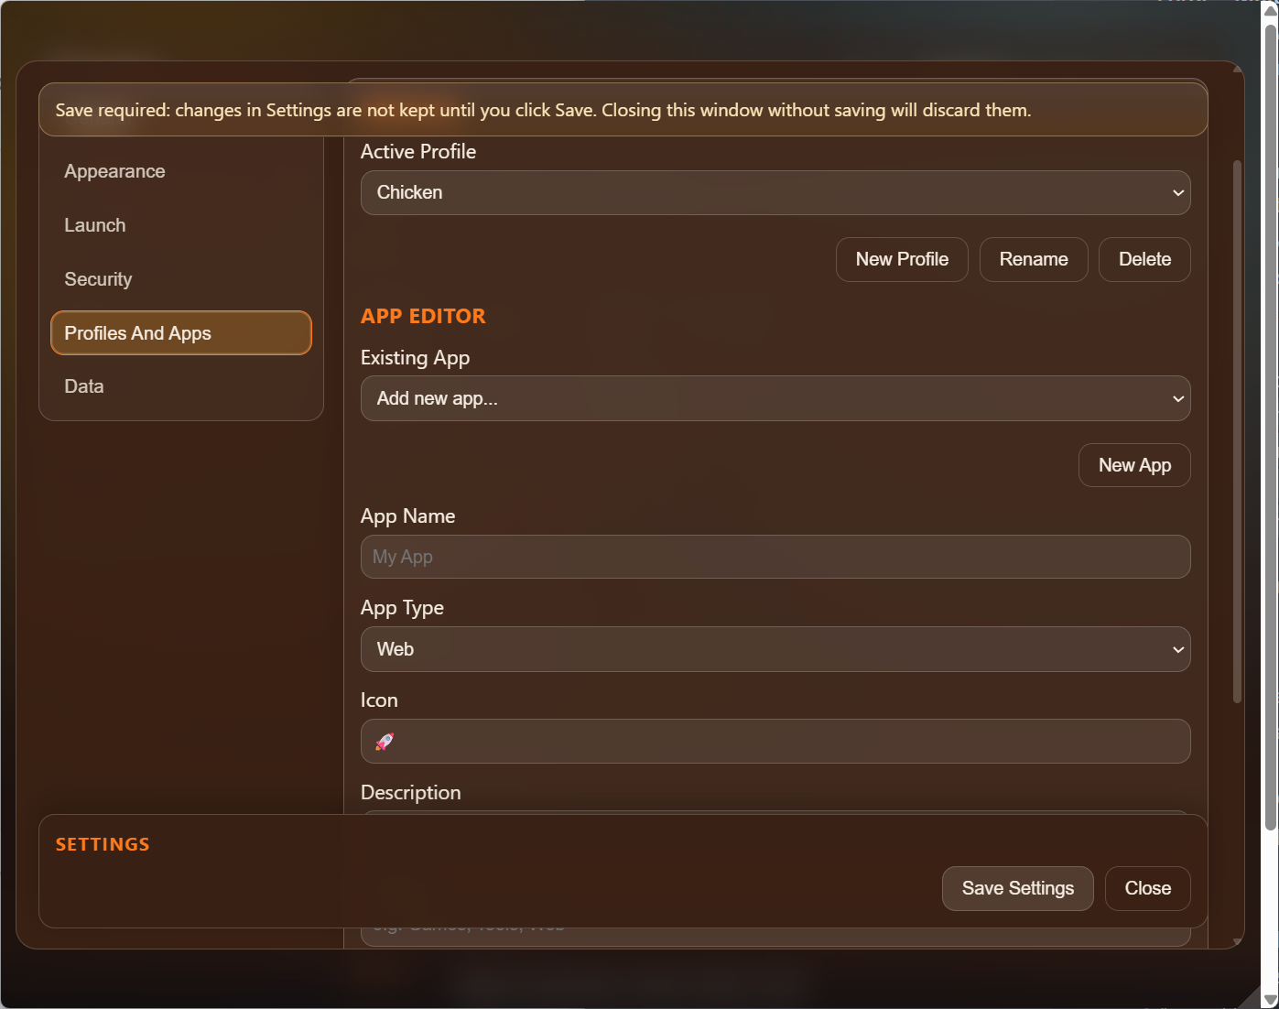
Product Overview
Desktop launcher built with Electron
Supports multiple app targets in one interface
Profiles separate layouts by context (work, gaming, etc.)
Designed for both mouse-first and keyboard-first users

Slide 4
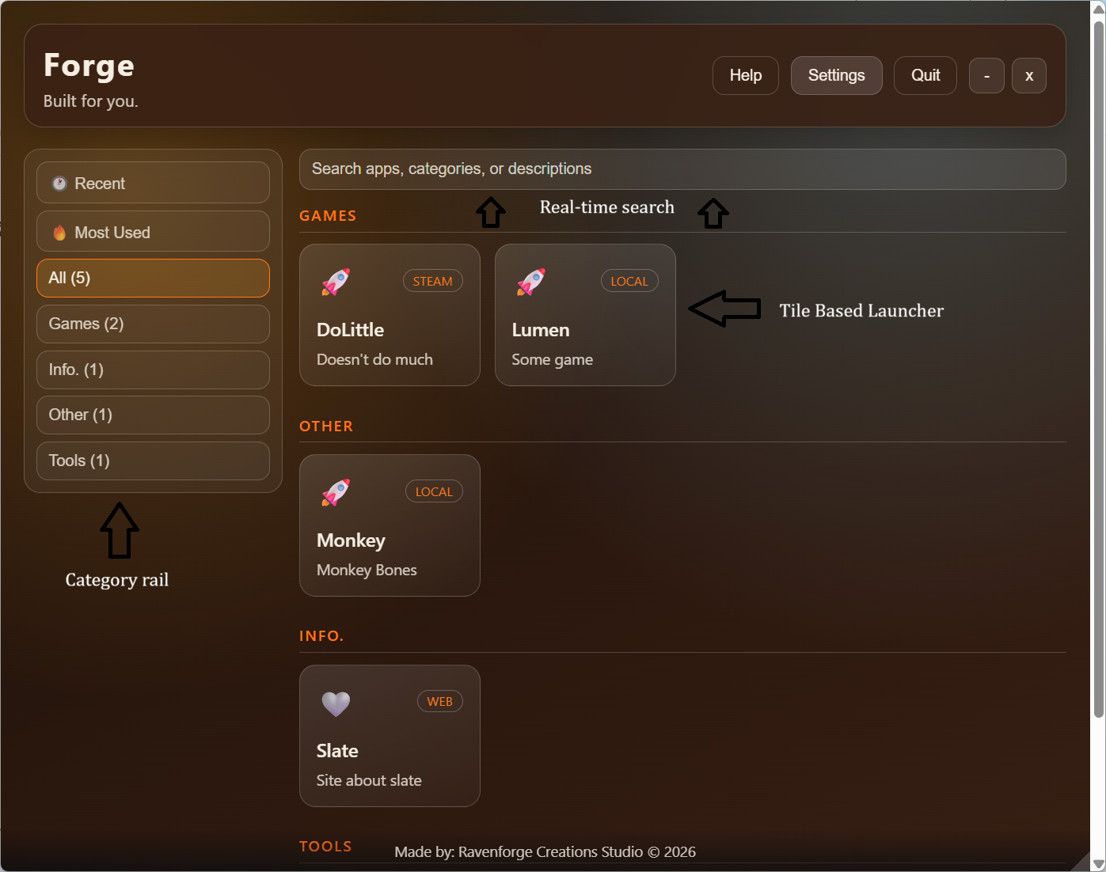
Core User Experience
- Tile-based launcher with drag-and-drop ordering
- Category rail for quick filtering
- Real-time search by name, category, and description
- Command palette for fast actions and navigation

Slide 5
App Types and Profiles
Supported app types:
Web URLs
Local executables/folders
Steam app launch targets
Profiles let users switch complete app sets instantly
App editor supports create/edit/delete with streamlined fields

Slide 6
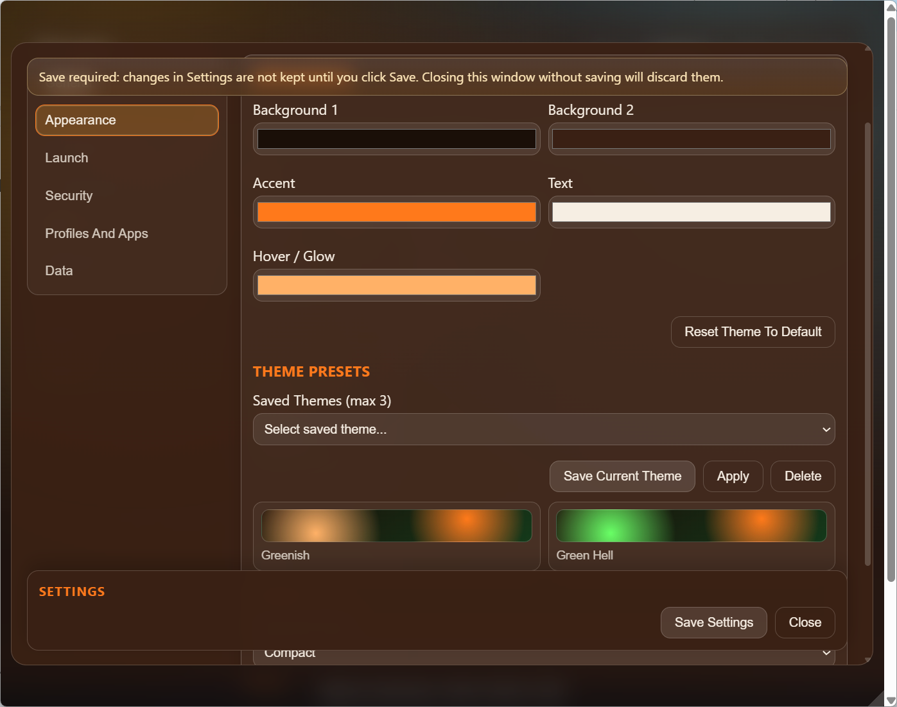
Accessibility and Keyboard System
- Arrow-key navigation in category rail
- Settings tabs support ArrowUp/Down, Home/End, Enter/Space
- Focus trap in modal dialogs to keep navigation predictable
- Theme preset thumbnails support Left/Right + Enter/Space

Slide 7
Settings and Personalization
- Tabbed settings architecture for clear organization
- Forge-themed default palette (ember/coal/iron direction)
- Full color customization (background, accent, text, hover/glow)
- Reset-to-default theme action for quick recovery

Slide 8
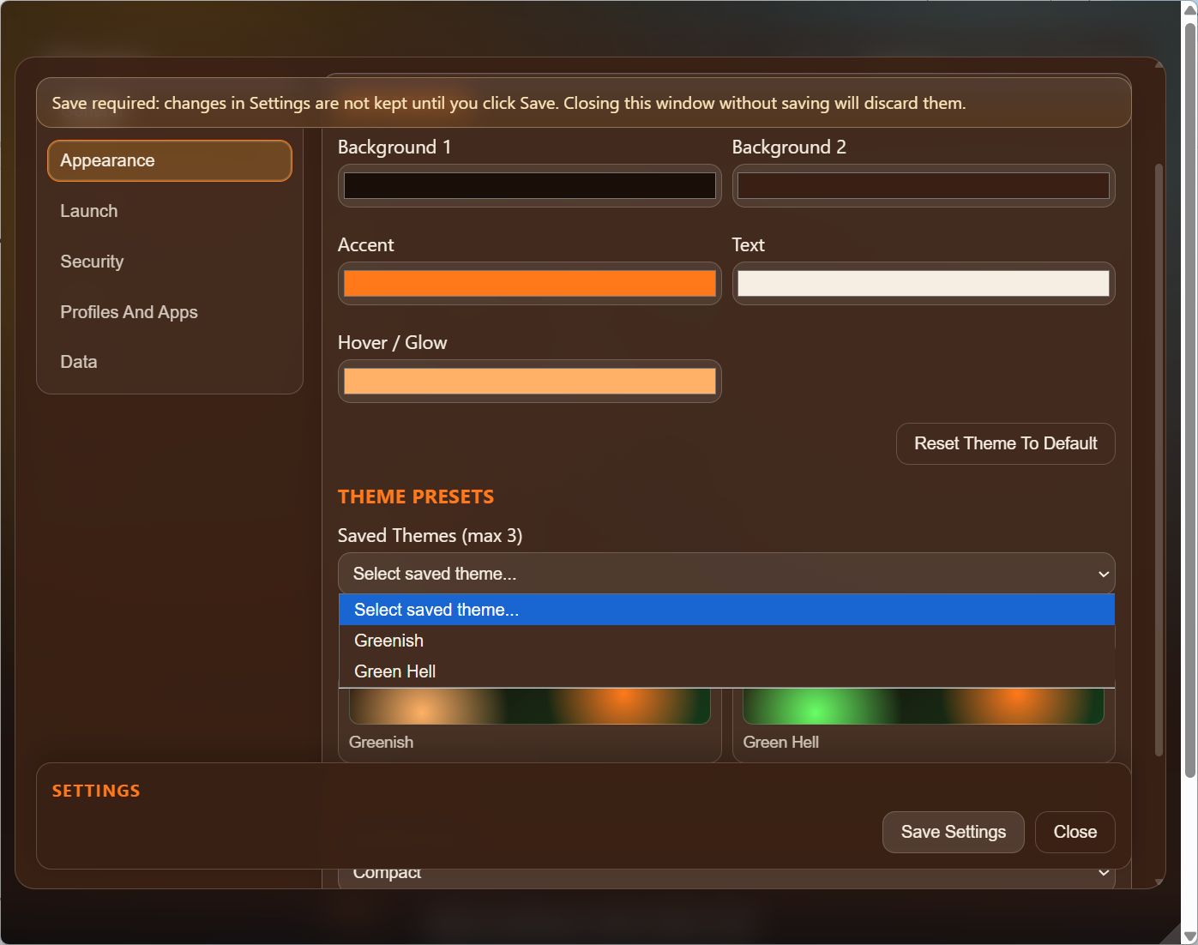
Theme Preset Workflow
- Save/apply/delete theme presets (max 3)
- Visual thumbnail previews for each preset
- Dropdown + thumbnail sync for consistent UX
- Safe preset merge logic prevents field-loss regressions

Slide 9
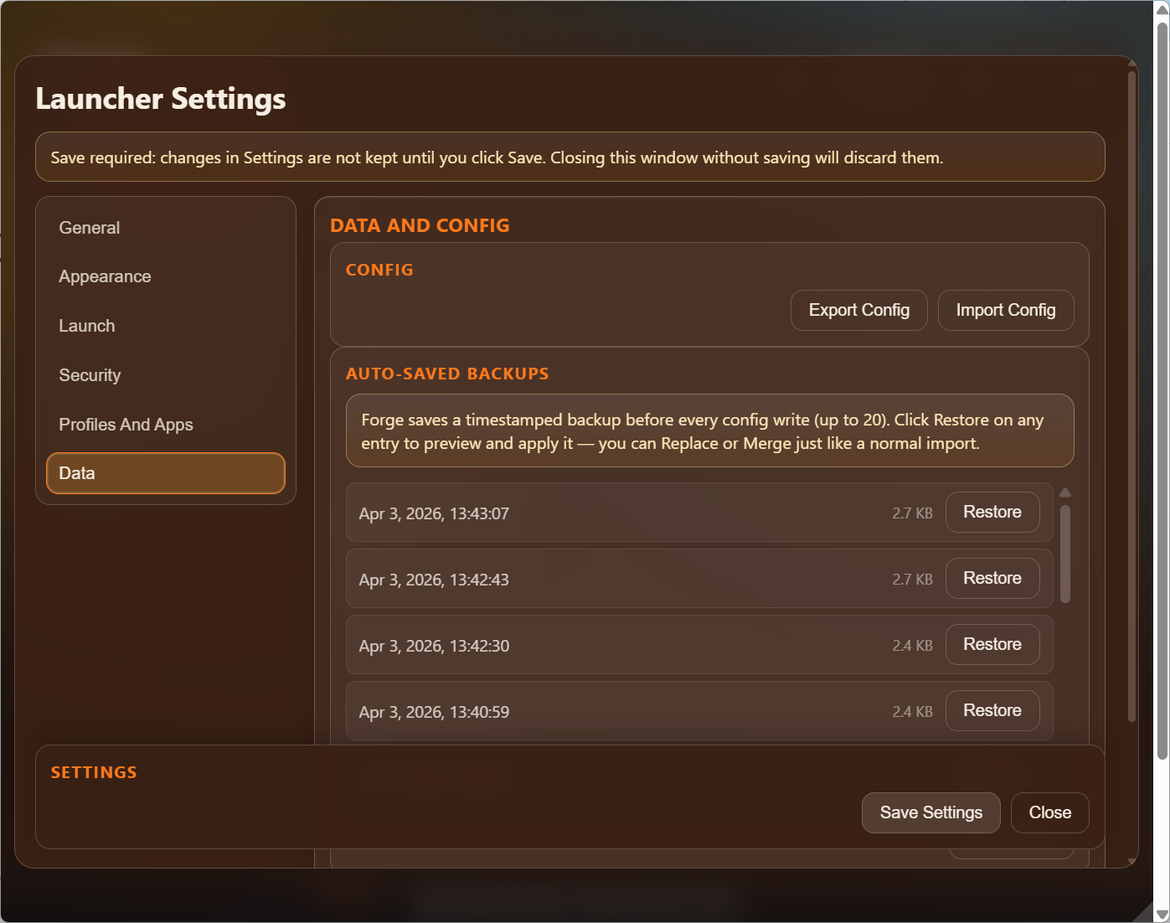
Data Safety and Recovery
- Encrypted config storage in desktop runtime
- Auto backup created before config writes
- Backup retention cap for storage control
- In-settings restore flow via backup list and import preview (replace/merge)

Slide 10
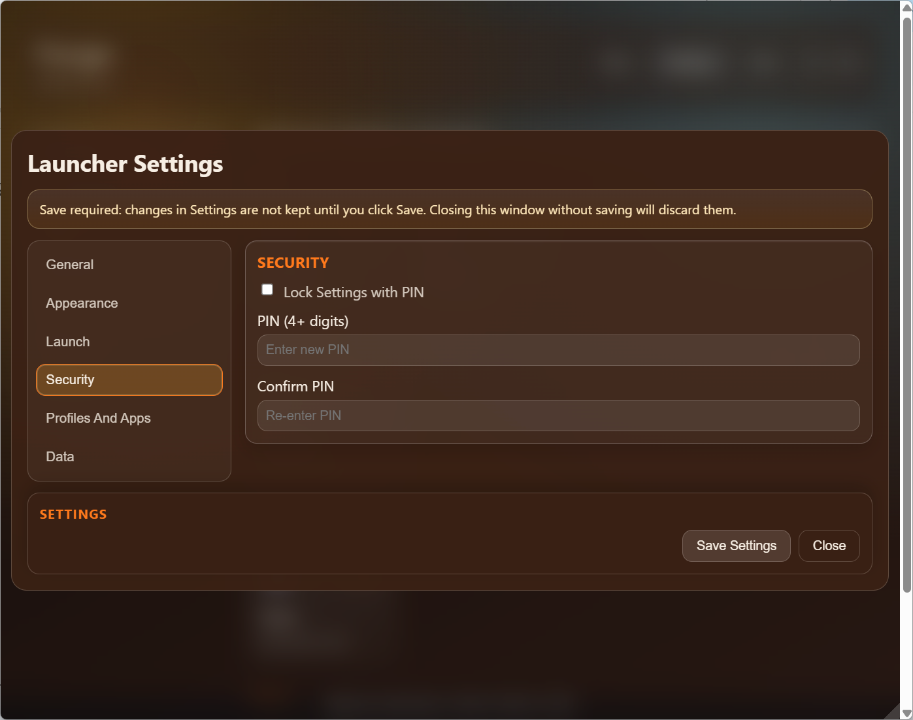
Health, Beta Status, and Next Steps
Health checks detect broken local paths
“Fix Path” button on broken tiles jumps directly to the app path editor
Current beta package ready for family/friend testing
Next steps:
Collect tester feedback
Prioritize UX refinements
Plan office/work toolkit spinoff on same framework

